Slide 1




Unlocking the archive
Wild & ranched Atlantic salmon growth over 62 years in the Burrishoole
Dr Aidan Long
A. P. Long, L. Vaughan, E. Tray, K. Thomas, N. Ó Maoiléidigh, R. Poole, D. Cotter, A. Doogan, D. Brophy

Slide 2
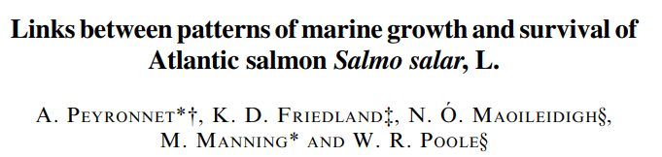
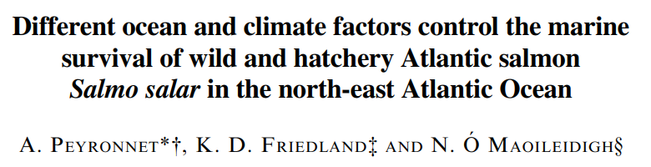
Growth, Survival & Ranching
Ranching?
Environment
Growth
Survival
Peyronnet et al. (2007), Peyronnet et al. (2008)

Slide 3
Study objectives
Describe growth trends in Burrishoole grilse
Compare growth of wild & ranched grilse
Investigate mechanisms of interannual trends

Slide 4
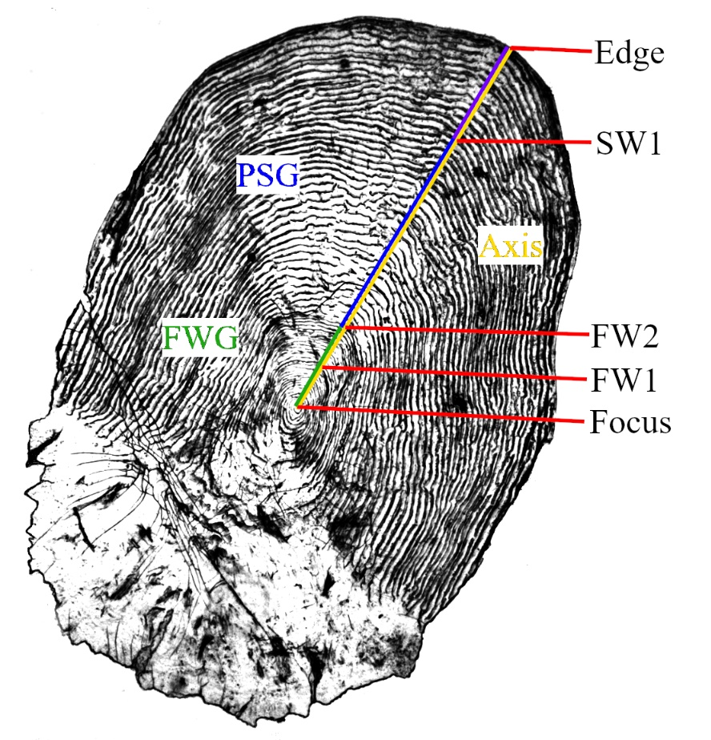
Growth from scales
Circuli & ICS
Related to body length/weight
FWG
PSG = critical growth period
PSG
FWG

Slide 5
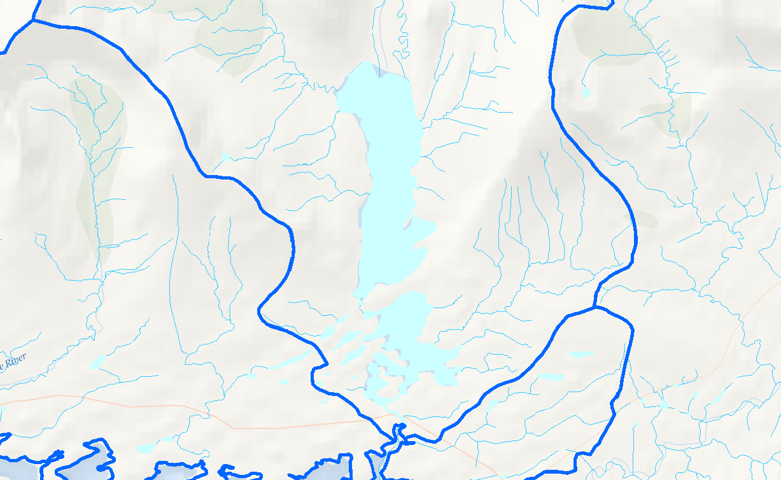
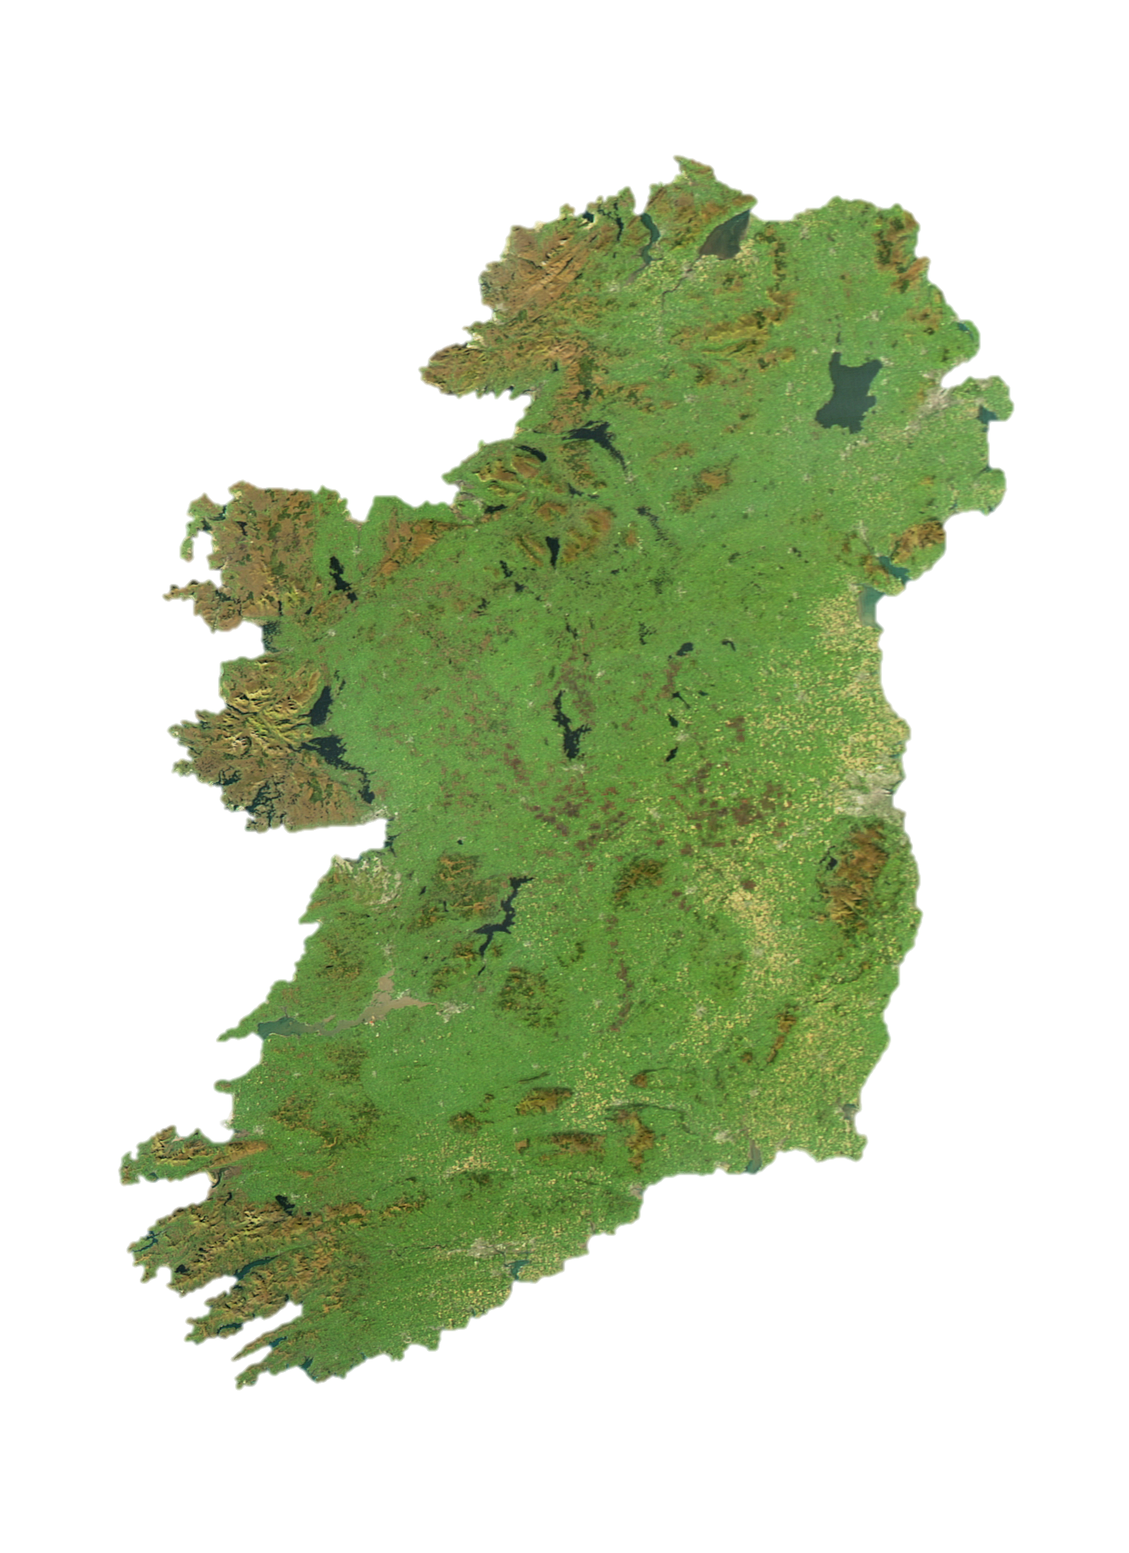
Data collection
Burrishoole
Catchment
Area
1SW fish
Wild: 1,976 scales (1956-2017)
Ranched: 1,725 scales (1980-2017)
(grilse)
2016

Slide 6
Growth models
Linear Mixed effects models of PSG data
Factors influencing variability of PSG
Intrinsic & extrinsic variables
Mixed effects GAMs of ICS data
ICS = non-linear
Identify decades where ICS trajectory was unique
Ranched and wild decade grps
Biological growth strategy models
Scale growth & return size data
Investigate compensatory & catch-up growth in both pop’s

Slide 7
Progression of growth
Wild
Freshwater growth (FWG)
Ranched
Total growth
Post smolt growth (PSG)

Slide 8
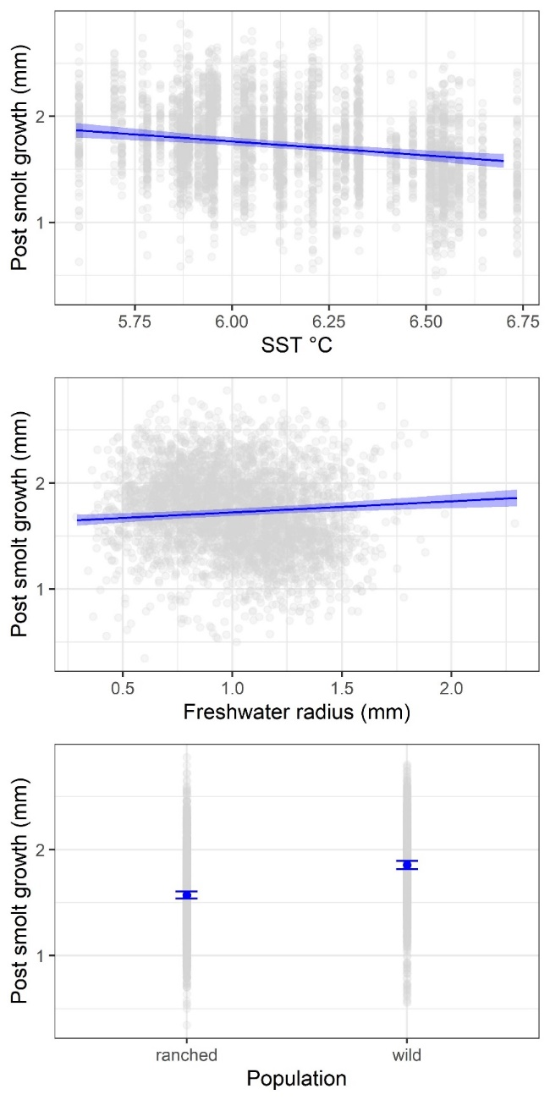
PSG model results
Optimal model: PSG ~ FWG + pop. type + F. Nor. SST + (pop. type | smolt year)
Autumn SST in Norwegian Sea (negative)
FWG (positive)
Fish origin
(Wild > Ranched)

Slide 9
ICS model results
Optimal model: ICS ~ Group + smooth (CircN, by=Group) + (1|ID)
Term | Estimate | SE | T | p
Intercept | 5.7 x 10⁻² | 8.17 x 10⁻⁴ | 68.96 | < 0.01
wild 60s | 1.12 x 10⁻³ | 1.01 x 10⁻³ | 1.12 | 0.26
wild 70s | 5.69 x 10⁻⁴ | 9.67 x 10⁻⁴ | 0.59 | 0.55
wild 80s | 5.75 x 10⁻⁵ | 9.82 x 10⁻⁴ | 0.06 | 0.95
wild 90s | -6.43 x 10⁻⁴ | 1.06 x 10⁻³ | -0.61 | 0.54
wild 00s | -4.09 x 10⁻³ | 1.15 x 10⁻³ | -3.54 | < 0.01
wild 10s | -4.35 x 10⁻³ | 1.06 x 10⁻³ | -4.10 | < 0.01
ranched 80s | -9.01 x 10⁻⁵ | 9.82 x 10⁻⁴ | -0.09 | 0.92
ranched 90s | 1.81 x 10⁻³ | 9.67 x 10⁻⁴ | 1.86 | 0.06
ranched 00s | -2.73 x 10⁻³ | 9.68 x 10⁻⁴ | -2.83 | < 0.01
ranched 10s | -3.38 x 10⁻³ | 1.11 x 10⁻⁴ | -3.04 | < 0.01

Slide 10
Return size
Wild
Ranched
Return
Length
Long-term in length & weight
After 2000s: Ranched fish 3.5% longer & 11.2% heavier than wild fish
Return
Weight

Slide 11
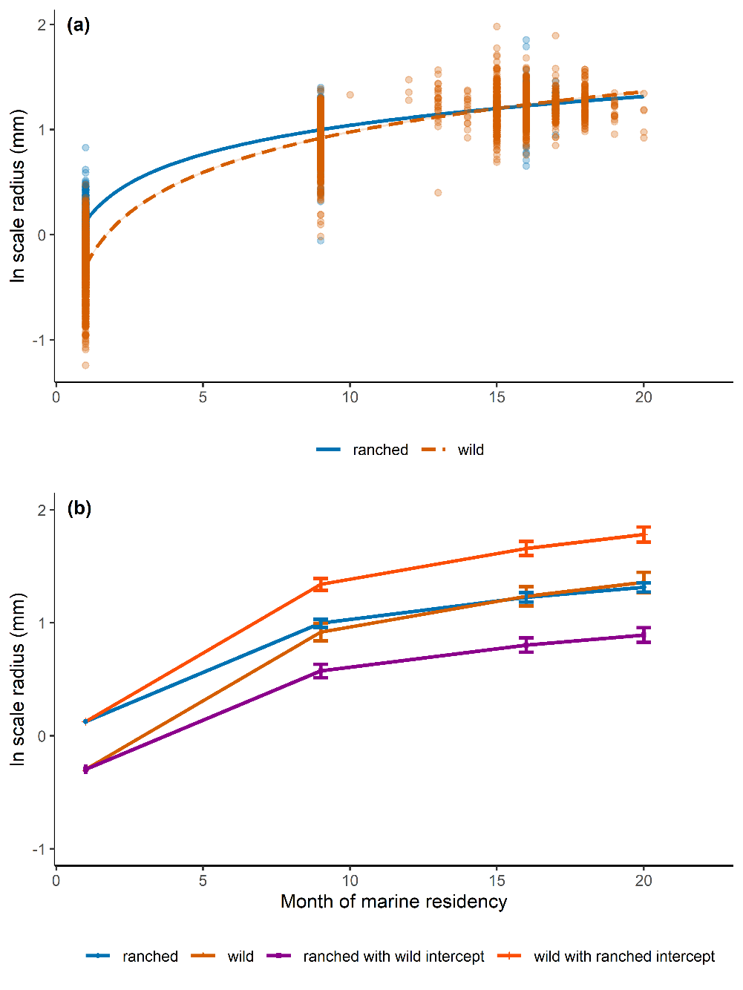
Compensatory growth
Wild
Ranched
Month of marine residency
Wild with ranched growth
ranched with wild growth
growth at sea = non-linear
growth rate varied between wild & ranched
Theoretical growth plots
not size-dependent growth but a compensatory response
Notes:
On left: scale growth at sea was non-linear & rate of growth varied between pops.
On right: Theoretical fish with same scale radius on entry, but different pop-specific growth rates = wild fish had enhanced growth at sea vs ranched fish & faster growth wasn’t just size-dependent growth but rather a compensatory response

Slide 12
Compensatory growth
Facultative response that maximises long-term fitness & well documented in salmon
Higher food intake, higher predation risk
Falls in line with the “Critical size hypothesis”
Wild fish did this to reach a threshold size and ensure survival in the marine environment
Peyronnet et al. (2007)

Slide 13
Declining PSG across NEA
Similar trend in PSG in other European catchments
North Esk - no. summer growth checks after 2000
Drammen - Gradual PSG from 1980s to 2000s
Imsa - length & condition factor of grilse after 2000
Todd et al. (2021), McCarthy et al., 2008, Jonsson et al., 2016

Slide 14
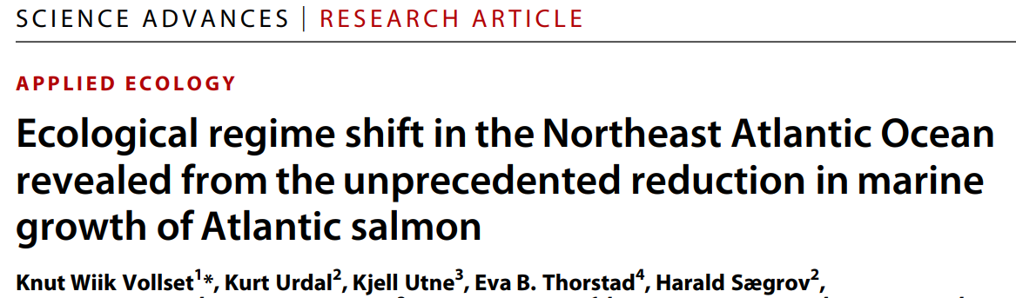
SST & post smolt growth
1 explanation: Indirect – Large-scale changes in the oceanographic regime of the NEA due to basin-wide ocean warming
Subsequent biological changes in migration corridor (NEA shelf waters) & Norwegian Sea (overwinter)
et al. (2021)

Slide 15
Conclusions
PSG in Wild & ranched grilse has declined in Burrishoole esp. after 2000
Relative difference in size between ranched and wild fish during marine phase due to compensatory growth of wild fish
marine growth in grilse common to many NEA catchments from climate-driven ecosystem changes
Compensatory growth in wild fish importance

Slide 16
Any questions?
References
Jonsson, B., Jonsson, N., & Albretsen, J. (2016). Environmental change influences the life history of salmon Salmo salar in the North Atlantic Ocean. Journal of Fish Biology, 88, 618–637.
McCarthy, J. L., Friedland, K. D., & Hansen, L. P. (2008). Monthly indices of the post-smolt growth of Atlantic salmon from the Drammen River, Norway. Journal of Fish Biology, 72, 1572–1588.
Peyronnet, A., Friedland, K. D., & Ó Maoileidigh, N. (2008). Different ocean and climate factors control the marine survival of wild and hatchery Atlantic salmon Salmo salar in the north-east Atlantic Ocean. Journal of Fish Biology, 73, 945–962.
Peyronnet, A., Friedland, K. D., Maoileidigh, N. Ó., Manning, M., & Poole, W. R. (2007). Links between patterns of marine growth and survival of Atlantic salmon Salmo salar, L. Journal of Fish Biology, 71, 684–700.
Todd, C. D., Hanson, N. N., Boehme, L., Revie, C. W., & Marques, A. R. (2021). Variation in the post-smolt growth pattern of wild one sea-winter salmon (Salmo salar L.), and its linkage to surface warming in the eastern North Atlantic Ocean. Journal of Fish Biology, 98, 6–16.
Vollset et al., (2021). Ecological regime shift in the Northeast Atlantic Ocean revealed from the unprecedented reduction in marine growth of Atlantic salmon. Science Advances, 8(9), eabk2542. https://doi.org/10.1126/sciadv.abk2542

